Slide 1
Null dynamics

Slide 2
Issues – predicting below shuffle (some days), predicting above full dynamics (big neuron days)
Approach:
Use full model, restrict A/b to null space
Left, add mean(potent)

Slide 3
Use full model, restrict output to null space Left, add mean(potent)
Day 2; r2_ = 0.07986, shuff = [0.032, 0.032], null_r2 0.08059
Day 4: r2_ = 0.07606, shuff = [0.023, 0.023], null_r2 0.07690

Slide 4
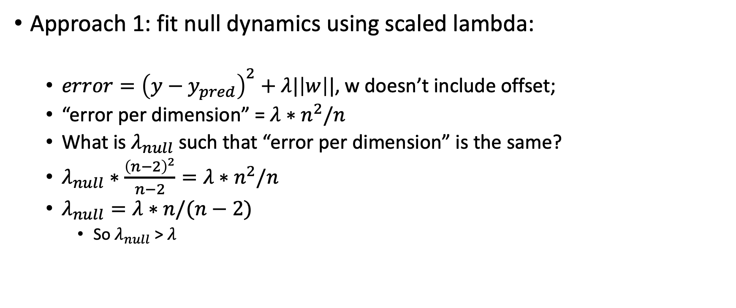
Use model optimized for null dynamics
Approach 1: fit null dynamics using scaled lambda:
$error={\left(y−y_{pred}\right)}^{2}+λ|\left|w\right||$, w doesn’t include offset;
“error per dimension” = $λ∗n^{2}/n$
What is $λ_{null}$ such that “error per dimension” is the same?
$λ_{null}∗\frac{{\left(n−2\right)}^{2}}{n−2}=λ∗n^{2}/n$
$λ_{null}=λ∗n/(n−2)$
So $λ_{null}$ > $λ$

Slide 5
Monkey G, day 2: r2_ = 0.07986, shuff = [0.032, 0.032], null_r2 0.08057
Monkey G, day 4: r2_ = 0.07606, shuff = [0.023, 0.023], null_r2 0.07691

Slide 6
Use null dynamics
Approach 2: optimize lambda for null dynamics

Slide 7
Monkey G, day 2: r2_ = 0.07986, shuff = [0.032, 0.032], null_r2 0.08057
Monkey G, day 4: r2_ = 0.07606, shuff = [0.023, 0.023], null_r2 0.07708

Slide 8
Day 2, 4
Other days, all neurons have higher null error than full model error (y-axis)
Other days, errors are generally higher (y-axis varies from 0--> 1)
Null better explains
Null better explains

Slide 9
Plot true vs. predicted activity, Day 0 – title says that null error > full model error

Slide 10
Plot true vs. predicted activity, Day 2– title says that null error < full model error

Slide 11
CONCERN: Autocorr. in potent
Black dot = Ridge on potent activity (2-dim but with all neurons)
Don’t know why some black dots are missing…

Slide 12
CONCERN: Potent predictions of activity
Black dot = no ridge, use potent
(2D) to predict activity

Slide 13
CONCERN: Potent predictions of activity
Black dot = no ridge, use command
(2D) to predict command

